Slide 1
MENOPAUSE
HORMONES &
GENITOURINARY SYNDROME OF MENOPAUSE
Everything you need to know
Mickey Karram, MD
Clinical Professor of Ob/Gyn & Urology
University of Cincinnati
Director of Urogynecology
The Christ Hospital

Slide 2
MENOPAUSE
& HORMONE OPTIMIZATION
Everything you need to know
Mickey Karram, MD
Clinical Professor of Ob/Gyn & Urology
University of Cincinnati
Director of Urogynecology
The Christ Hospital

Slide 3
Menopause: Definitions & Affects
What is it??
What can I expect??
How do I treat it??

Slide 4
HORMONE HAVOC?
What are hormones & why are they important?
What is hormonal imbalance?

Slide 5
HORMONE HAVOC
What do you need to know?
What can/should you believe?
What can you potentially do?

Slide 6
WHAT ARE HORMONES?
Chemical messengers made by the endocrine glands that act to control certain actions of the cells and organs
Work in a lock & key fashion
DO WE AGE BECAUSE WE LOSE OR HORMONES?
OR DO WE LOSE OUR HORMONES BECAUSE WE AGE?

Slide 7
SOUND FAMILIAR?
Extreme fatigue
Mood swings
Tension & irritability
Lack of sleep (3-4 am wakeup)
Memory Loss
Depression
Lack of Focus
Vaginal dryness
Brain fog
Hot flashes
Night sweats
Joint pain
Bladder symptoms
Migraine/severe headache
Decreased sex drive and/or performance

Slide 8
CONVENTIONAL HORMONE REPLACEMENT METHODS
Women’s Health Initiative (WHI) trial 2002….flawed study!
41% increase in stroke
29% increase in heart attacks
26% increase in breast cancer
2x the rate of blood clots
76% increase in Alzheimer’s disease
THIS WAS A FLAWED STUDY!
MANY WOMEN WERE LEFT WITH NO ALTERNATIVE FOR HORMONE BALANCE & SYMPTOM RELIEF!

Slide 9
HORMONE REPLACEMENT METHODS
SYNTHETIC
Pills
Patches
Shots
BIOIDENTICAL
Pills
Patches
Creams/Gels
Pellets

Slide 10
POSITIVE EFFECTS OF NATURAL ESTROGEN
Controls hot flashes
Maintains collagen in skin
Increases serotonin & dopamine(happy hormones in brain)
Maintains bone density
Increases bone strength
Helps maintain memory
Helps prevent neurodegenerative conditions
Lowers cholesterol & increases HDL
Protects bone, breast, brain & heart

Slide 11
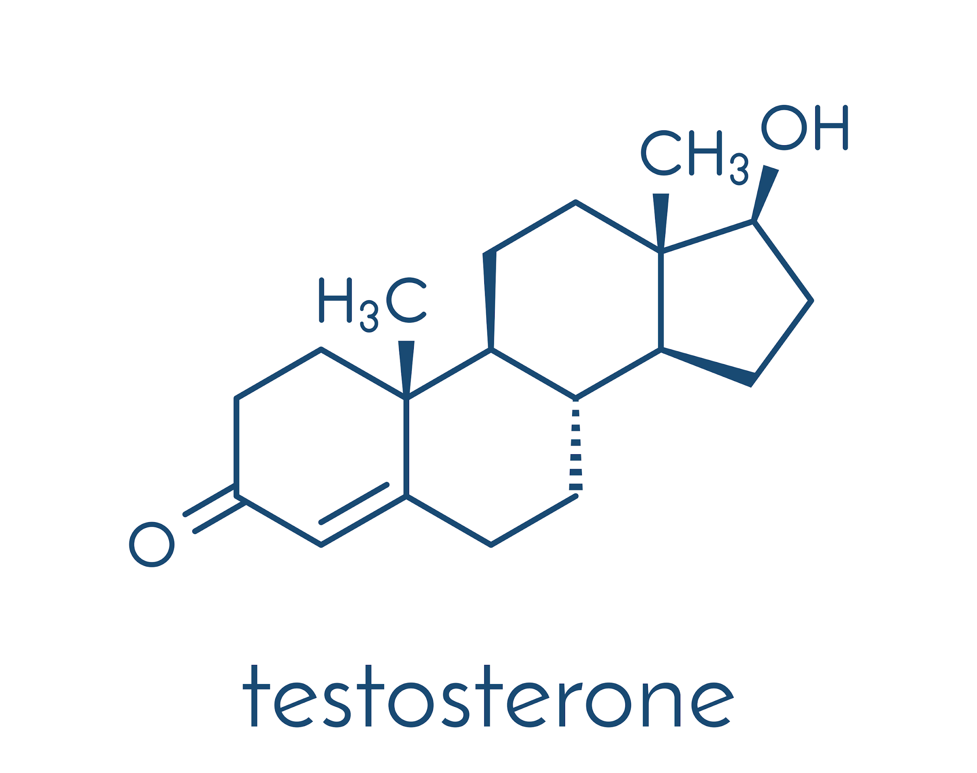
FACTS ABOUT TESTOSTERONE
Provides major symptom relief and protects the BONES, BRAIN, BREAST, HEART & RELATIONSHIPS
Present in both men & women
Large amounts in men – small amounts in women
Men age 30-70 will lose 1-3% production per year
Women age 20-40 lose up to 50% per year!

Slide 12
POSITIVE EFFECTS OF TESTOSTERONE
Increased energy, vitality and zest for life
Improved feeling of overall wellbeing
Depression relief
Anxiety relief
Improved cognitive clarity
Improved memory
Improved focus
Enhanced libido
Enhanced performance
Breast protection
Prostate protection
Brain protection
Heart protection
Bone protection
Increased bone strength
Increased muscle strength
Reduced body fat
Lower cholesterol

Slide 13
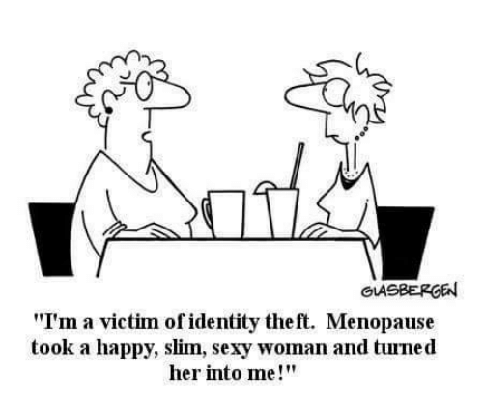

Slide 14
VAGINAL ATROPHY
Understanding Genitourinary Syndrome of Menopause (GSM)
Mickey Karram, MD
Clinical Professor of Ob/Gyn & Urology
University of Cincinnati
Director of Urogynecology
The Christ Hospital

Slide 15
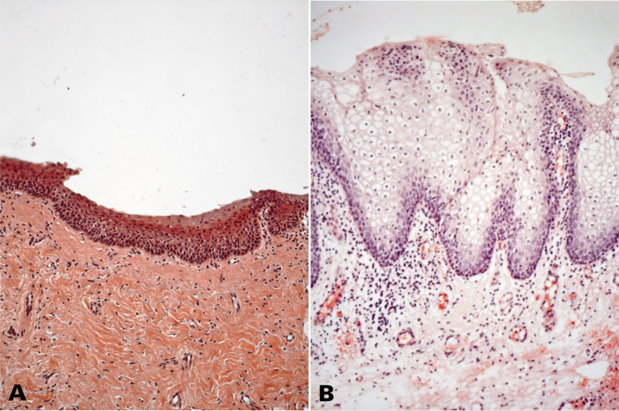
ALTERATION OF THE EPITHELIUM
When estrogen levels start to decline, the epithelium gets thinner and becomes more susceptible to trauma (the epithelium protects the mucosa also against mechanical friction during sexual intercourse).
(A): Post-menopausal vaginal mucosa with atrophy caused by decreased oestrogen levels with reduced presence of vessels and a significantly thinner epithelium with lack of glycogen. (B): Vaginal mucosa in reproductive age; the mucosa is well supplied with blood and the epithelium consists of a larger number of cell layers, particularly rich in glycogen. Histology courtesy of Prof. A. Calligaro - University of Pavia, Italy.

Slide 16
Symptoms Associated GSM
Vaginal or vulvar dryness
Burning
Dyspareunia
Lower urinary symptoms of dysuria, urgency & frequency

Slide 17
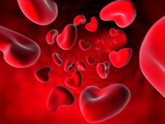
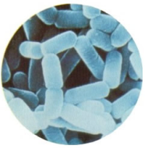
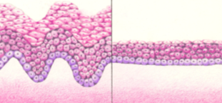
PATHOGENS OF GSM
The decline in estrogen levels associated with menopause are closely linked to:
Reduction of blood flow and vaginal secretion (vaginal dryness)
Morphological alterations of the epithelium of the vaginal mucosa
Decrease of vaginal lactobacilli and increase of vaginal pH levels

Slide 18
PREVALENCE OF GSM
Prevalence estimates vary but approximately half of postmenopausal US women report these atrophy-related symptoms and the negative effect on quality of life is substantial
Unlike vasomotor symptoms that tend to decrease over time , genitourinary syndrome of menopause will not spontaneously remit and commonly recurs when hormones are withdrawn

Slide 19
BREAST CANCER STATISTICS

Slide 20
CURRENT TREATMENT OPTIONS
Replace estrogen; systemically or locally
Moisturizers
Precursors to estrogen

Slide 21
ENERGY SOURCES
LASER SYSTEMS
CO2 Lasers
Erbium YAG Lasers
RADIOFREQUENCY DEVICES

Slide 22
