Slide 1
URINARY INCONTINENCE
What is it & How can I treat it?
Mickey Karram, MD
Clinical Professor of Ob/Gyn & Urology
University of Cincinnati
Director of Urogynecology
The Christ Hospital

Slide 2
What is Urinary Incontinence?
ICS (International Continence Society) Definition:
“The complaint of any involuntary leakage of urine”
What’s wrong with this definition?
Many studies suggest that 40-50% of women who leak never actually complain to anyone else
WHY??

Slide 3
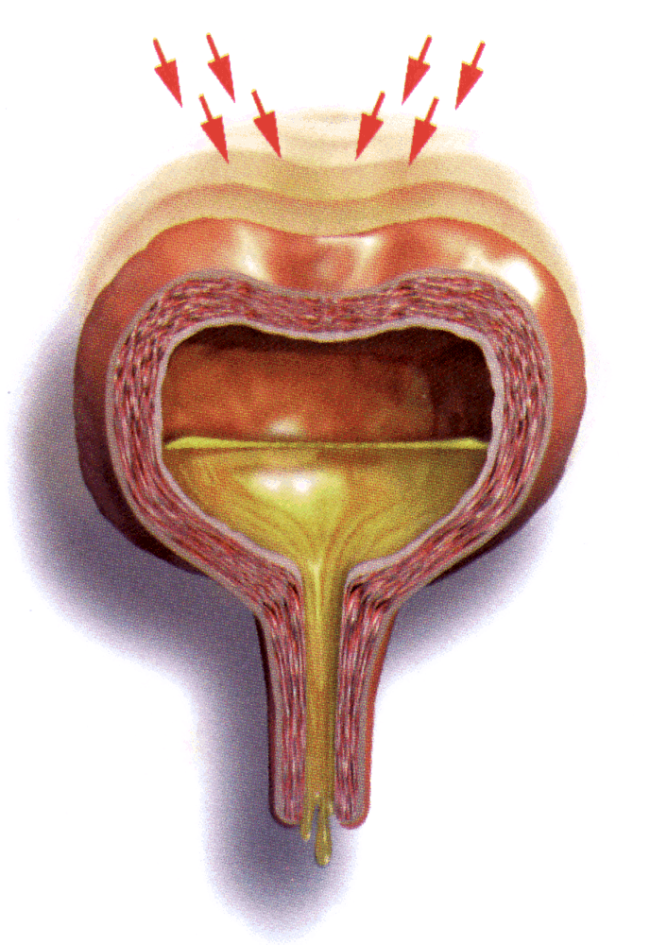
Urge Incontinence
Urge incontinence: Involuntary leakage accompanied by or immediately preceded by urgency
Often very sudden, without warning
May be precipitated by the sound of running water, cold, “key in the door”, leaking on the way to the toilet
Amount of urine lost often large
Represents over-activity of the bladder muscle (OAB)
Most often the cause is unknown

Slide 4
Stress Incontinence
Stress incontinence: Involuntary leakage of urine that occurs simultaneous with an increase in intra-abdominal pressure
Usually predictable
May precipitated by coughing, laughing, sneezing, lifting etc.
Amount of urine lost is usually small spurts
Represents compromise of the urethral tubes

Slide 5
Stress Incontinence
DO YOU SUFFER ALONE?
Stress incontinence: Involuntary leakage of urine that occurs simultaneous with an increase in intra-abdominal pressure
Usually predictable
May be precipitated by exercise, coughing, sneezing, lifting, etc.
Amount of urine lost is usually small spurts
Represents compromise of the urethral tube?

Slide 6
How common is incontinence?
Depends upon definition (daily, weekly, any, and degree of bother)
Literature review mean prevalence
27.6% of women > age 20 weekly UI (range 4.8-58.4)
28.4 million women in the US
7% defined leakage as “bothersome”
7.2 million women in the US
Women are affected 8 times more often than men

Slide 7
TOP CHRONIC CONDITIONS IN THE US
40
35
30
OAB
25
Millions
20
15
10
5
0
Chronic bronchitis¹
Chronic sinusitis¹
Hay fever/ Allergic rhinitis¹
Asthma¹
Ulcer¹
Arthritis¹
High cholesterol¹
Diabetes¹
Incontinence²
Heart disease¹
1. National Center for Health Statistics. Vital health stat 10;1994.
2. Fantl JA et al. AHCPR Publication No 96-0682;1996.

Slide 8
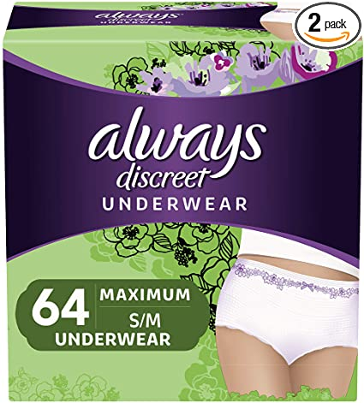
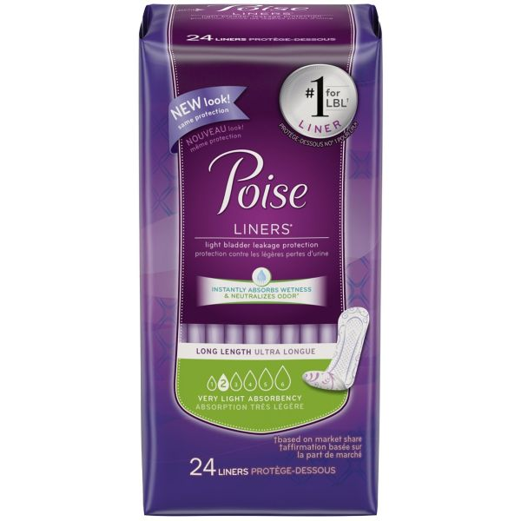
ADULT DIAPER INDUSTRY

Slide 9
OAB Syndrome Comorbidity
Falls and fractures (increased risk)
Urinary tract infections (increased risk)
Skin infections (increased risk)
Sleep disturbances
Depression
Frequency

Slide 10
THE FINAL TABOO
70% of women with UI say they worry about coughing, sneezing and even laughing in public for fear of having an accident
35% report avoiding exercise, traveling less frequently and avoiding sex to accommodate
62% wait a year or longer before discussing their condition with a doctor
17% wait 5 or more years
SHAME ON US! – 9/10 women who discuss UI with providers say they initiated the conversation!

Slide 12
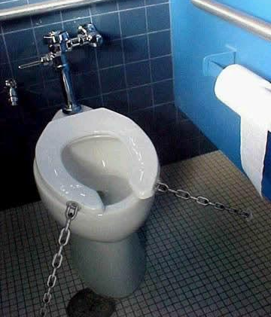

Slide 14
URGE INCONTINENCE TREATMENTS
Behavioral Therapy
Bladder diet - avoid bladder irritants
Bladder retraining – timed voiding
Urge suppression techniques
Medicines
These therapies are more effective in combination than alone
Special treatments for patients who fail all of the above
Botox injection in the bladder
Neuromodulation

Slide 15
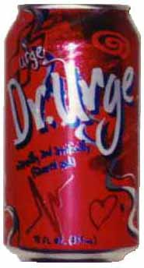
DIETARY MODIFICATIONS
Many dietary substances can affect lower urinary tract storage by affecting bladder nerves or by acting as direct irritants
Such substances include:
Caffeine (coffee, tea and yes, chocolate)
Alcoholic beverages
Acidic fruit or fruit juices
Tomato products
Spicy foods
Milk products
Sugars
Artificial sweeteners

Slide 16
BLADDER RETRAINING
Goal is to modify bladder function to extend time between voids, decreasing urgency/frequency
Begin to void by the clock not by desire:
Start with a comfortable interval
Extend the interval by 15-30 minutes when comfortable 3-5 days
Goal is to get to 3-4 hours
Use urge suppression techniques (to follow)

Slide 17
PELVIC FLOOR REHABILITATION
Learn how to APPROPRIATELY Kegel
When you feel a sudden urge to go to the bathroom; do not get into a race with your bladder YOU WILL LOSE
Appropriately contracting your pelvic floor will abort the bladder spasm

Slide 18
URGE SUPRESSION TECHNIQUES
Stop and stay still
Think about anything but the bathroom
Concentrate on 3 slow deep breaths
Squeeze pelvic floor muscles
Wait until the urge subsides
Walk to bathroom at normal pace

Slide 19
STRESS INCONTINENCE TREATMENTS
Pelvic floor rehabilitation
Energy Sources LASERS AND RF DEVICES
Injection of bulking agent; BULKAMID
Surgery; SLINGS ARE SAFE AND EFFECTIVE TREATMENTS ; WITH A LONG TRACK RECORD

Slide 20
MIXED INCONTINENCE
Mixed incontinence: involuntary leakage associated with urgency and also with exertion, effort, sneezing or coughing.
Mixture of urge incontinence and stress incontinence
The bladder is overactive and the urethra is under active
The urge component is more bothersome

Slide 21
MIXED INCONTINENCE TREATMENT
Both components will have to be treated based on predominance
THE BAD NEWS - Treating one occasionally makes the other worse
THE GOOD NEWS - Studies show however that the urge incontinence will resolve in 40-60% of patients when the stress incontinence is treated- especially if the urge is positional

Slide 22
STOP LEAKING: & Start Living Again!

